Slide 1
Chapter 2
Instructions: Language of the Computer
Notes:
The University of Adelaide, School of Computer Science
Chapter 2 — Instructions: Language of the Computer

Slide 2
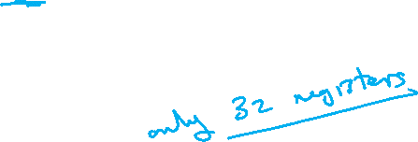
Stack Segment & Stack Pointer
The stack is used when we exhaustively used the registers and we cannot overwrite any of them
In that case we use the stack to store temporally the register values then over-write them and then read them back
Chapter 2 — Instructions: Language of the Computer — <number>
Notes:
The University of Adelaide, School of Computer Science
Chapter 2 — Instructions: Language of the Computer

Slide 3
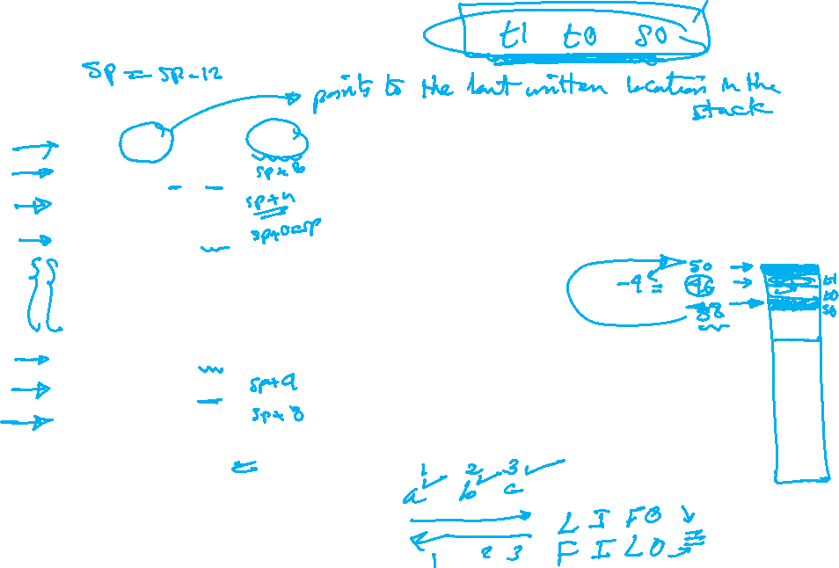
Stack Example
Example
addi $sp, $sp, –12 # adjust stack to make room for 3 items
sw $t1, 8($sp) # save register $t1 for use afterwards
sw $t0, 4($sp) # save register $t0 for use afterwards
sw $s0, 0($sp) # save register $s0 for use afterwards
add $t0,$a0,$a1 # overwriting $t0
add $t1,$a2,$a3 # overwriting $t1
sub $s0,$t0,$t1 # overwriting $s0
lw $s0, 0($sp) # restore register $s0 for caller
lw $t0, 4($sp) # restore register $t0 for caller
lw $t1, 8($sp) # restore register $t1 for caller
addi $sp,$sp,12 # adjust stack to delete 3 items
Chapter 2 — Instructions: Language of the Computer — <number>

Slide 4
Stack is LIFO or FILO!
Example – Cont.
addi $sp, $sp, –12
sw $t1, 8($sp)
sw $t0, 4($sp)
sw $s0, 0($sp)
add $t0,$a0,$a1
add $t1,$a2,$a3
sub $s0,$t0,$t1
lw $s0, 0($sp)
lw $t0, 4($sp)
lw $t1, 8($sp)
addi $sp,$sp,12
52
48
44
40
36
32
28
24
20
16
12
08
04
SP=40
$t1
Dump values and can be overwritten
$t0
SP=28
–12
$s0
Chapter 2 — Instructions: Language of the Computer — <number>

